Slide 1

The Forum: Measuring the Economic Impact of Child Care
July 13, 2020
Emilie Amundson, Secretary
Erin Arango-Escalante, Administrator, DECE
Notes:
ECE Landscape
Business Community Implications
Opportunities and next steps

Slide 2


Early Care & Education
Home visiting/Family Foundations Home Visiting (FFHV)
Parenting Support & Service Navigation
Health Programs
Early Intervention/Special Education
Head Start/Early Head Start
4-Year-Old Kindergarten
Child Care
Notes:
Birth to 5 is the most critical time in a child’s development. During their first five years, Wisconsin’s children can potentially be involved with multiple programs across multiple agencies. Consistent, responsive care is foundational to brain development & lays the groundwork for a child’s whole life.

Slide 3
Return on Investment
Economists have found a positive return on early care and education investments of $7 - $17 for every one dollar invested.
  Less remedial education
  Higher graduation rates
  Lower teen pregnancy
  Lower rates of incarceration
  Higher employment rates
  Higher rates of home ownership
  Less likelihood of dependence on public assistance
  Better long-term health outcomes

Slide 4

Measuring the Economic Impact of Child Care
Pre-COVID 19: Child Care Crisis
78% of parents of children under 3 are in the workforce
$57B in lost earnings, productivity and revenue
86% of working parents said problems with child care hurt efforts and time commitment at work – falling behind, missed work, absences
1/3 of “high potential” women drop out of the workforce every year because of child care challenges

Slide 5

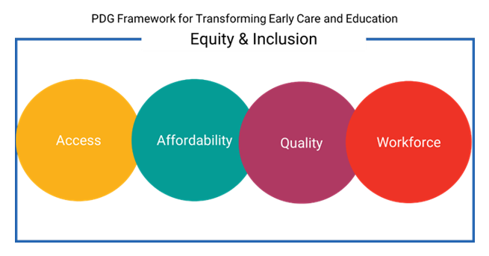
Connecting the Dots:
WI’s Economy and Child Care
Notes:
Equity & Inclusion Lens: An Equity and Inclusion Lens is a transformative tool used to:
Identify systemic and institutionalized racism, bias, disparity and inequality in practices, policies, procedures and programming
Analyze data and information for racism, bias, disparity and inequity
In order to:
Move towards more equitable and inclusive planning, programing, decision-making and resource allocating
Ensure that everyone, particularly members of underrepresented groups (communities of color, low socioeconomic populations, vulnerable populations, people with disabilities and other disenfranchised peoples) are included as equal participants at every level of policy, procedure and program processes
Work to equalize power in decision-making and opportunities for self-governance
So that: all Wisconsin children and youth are safe and loved members of thriving families and communities.

Slide 6
Connecting the Dots:
WI’s Economy and Child Care

Slide 7

Access: February 2020
Statewide
  4,500 programs
  172,000 slots
Rural communities
  Almost 80% live in desert
2010-2020
  9% decrease in group programs
  68% decrease in family programs
~50% live in a child care desert
Notes:
in rural WI this jumps to close to 80%
Close to 75% of children 4 and under are in care outside the home

Slide 8
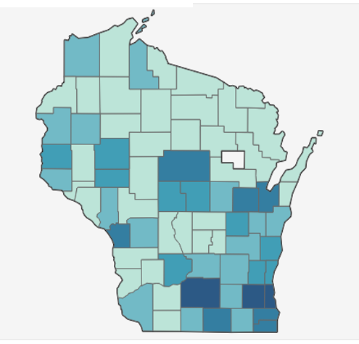
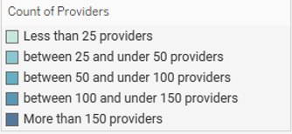
Access: February 2020
Notes:
Equity & Inclusion:
Geography impacts accessibility of child care
Even in areas such as Milwaukee County, where there are a high number of providers, gaps exist
In rural areas, family child care, the primary regulated option, has been declining

Slide 9
Access: May 2020
Statewide
  2,500 programs
  85,000 slots
SE urban communities
  Lost 61% of group programs (41,000 slots)
Family child care programs
  84% still operating
  11,000 slots
% live in a child care desert
Notes:
Increase from May- July in number of programs, still gaps, SE hit hard

Slide 10
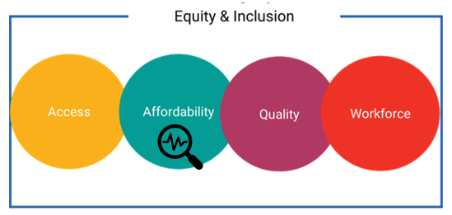
Connecting the Dots:
WI’s Economy and Child Care
Notes:
Family:
49% of the annual income of the average single parent in WI
Child Care Provider:
Operate on razor thin margins
30% of programs indicate they could not survive a closure of more than 2 weeks

Slide 11
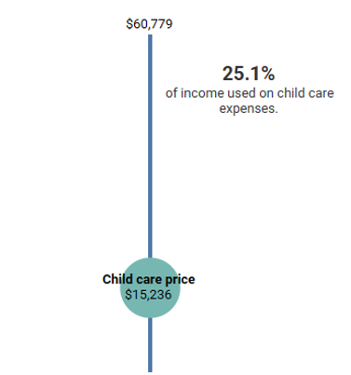
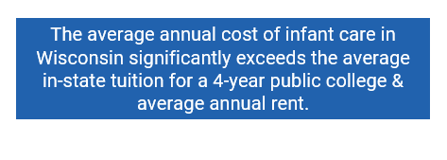
Affordability
Median Income Comparison to the Cost of Infant Care at Licensed Group Centers
Notes:
Median Household Income=50% of State makes more & 50% makes less=the exact middle point. The median household income in Wisconsin is the $ amount at the top. The circle is the average cost of infant care at a licensed group center in Wisconsin. The percentage is the proportion of a household making the median income spends on average cost.
Factors to think about: more than 1 child, less than household income, different costs of care
Family:
49% of the annual income of the average single parent in WI
A family with a school-age child 6+ will pay 2.2x the affordable amount.
A family with a child 0-1 in a group child care setting will pay 3.6x the affordable amount.
The average annual cost of infant care in Wisconsin significantly exceeds the average in-state tuition for a 4-year public college & average annual rent.
Equity & Inclusion:
For families making less than the median income, this gap is even greater.
Single-parent families are at a greater disadvantage than two-parent families.
In many counties, Blacks & Hispanics make less than Whites, making affording child care an even greater driver of economic hardship.
Wisconsin Shares Child Care Subsidy participation has been steadily declining.
Families who qualify do not participate.
The gap between the subsidy rate & the cost of care may still leave families unable to afford child care.
Equity & Inclusion:
Children receiving WI Shares Child Care Subsidy must enroll in a YoungStar-participating program. However, YoungStar participation is decreasing. Families may be unable to access a YoungStar participating provider, leaving them unable to access WI Shares.

Slide 12
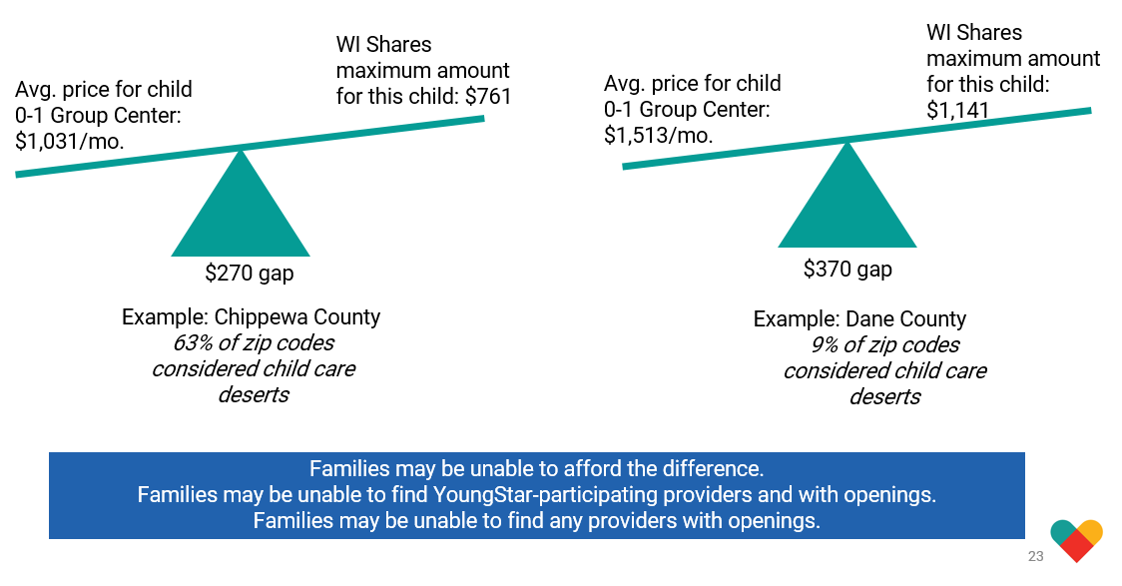
Affordability

Slide 13
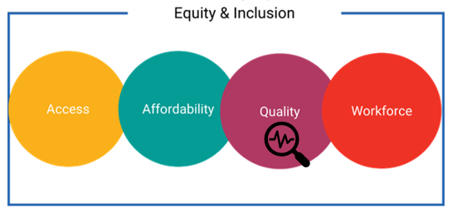
Connecting the Dots:
WI’s Economy and Child Care
Notes:
Explain quality and QRIS

Slide 14
Quality
20% Decrease in Number of YoungStar Participating Providers Between December 2013 & May 2020
Dec Dec Dec Dec Dec Dec Dec May

Slide 15
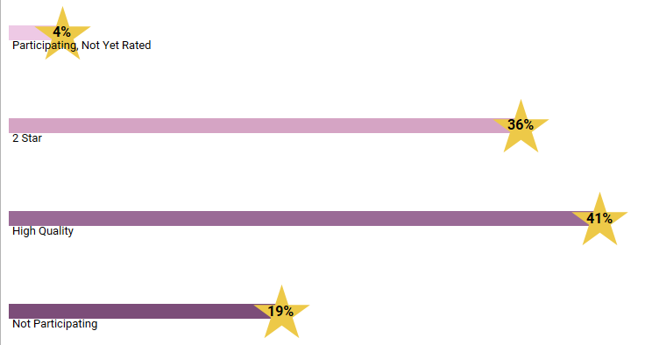
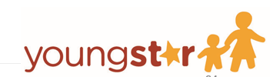
Quality
Notes:
Statewide: 81% of YS participating providers are considered “High Quality” & have a 3-5 Star rating Data pulled as of February 2020
Equity & Inclusion:
The location of 3-5 Star programs varies, families may not have access to a high quality provider near where they live or work.
Not all programs participate in YoungStar & so are not rated.
For families, the definition of quality may involve different factors than YoungStar system measurements.

Slide 16
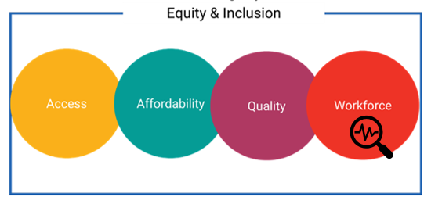
Connecting the Dots:
WI’s Economy and Child Care

Slide 17
Workforce
52% of child care teachers have at least an Associate Degree or more
Earning $10.72/hour vs. $18/hour ($2,000 less than US average)
53% of child care teachers receive at least one form of public assistance
Close to a 40% turnover rate for all child care teachers
Notes:
Child care programs are leaving classrooms vacant because they cannot hire teachers.
Equity & Inclusion:
Staff at child care programs with 50% or more children with child care subsidies had lower wages, were less likely to have a degree and had a higher turn over rate.
The Southeastern Region has more racially/ethnically diverse child care professionals compared to the rest of the state.
In Milwaukee, 41% of child care professionals identify as Black or African American and 11% identify as Hispanic.

Slide 18
Connecting the Dots:
WI’s Economy and Child Care
Notes:
Connect Framework to CCC and future opportunities

Slide 19
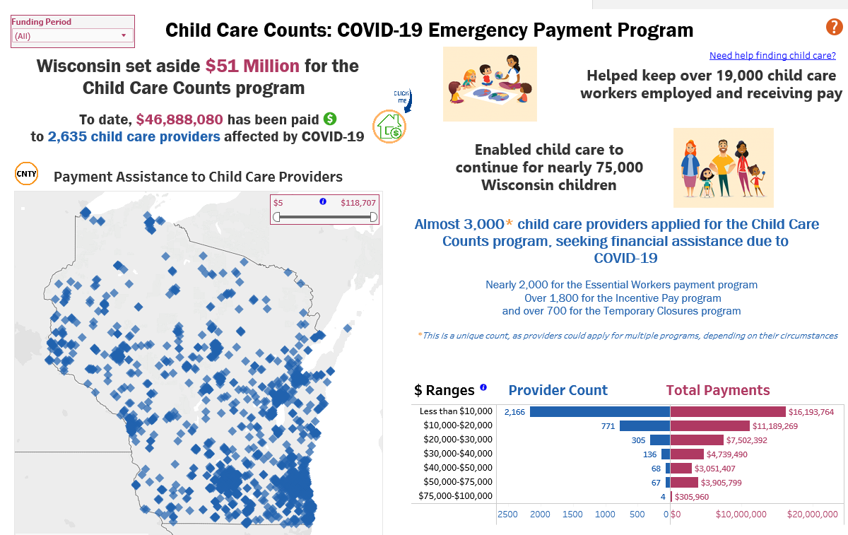
ROI
Notes:
Discuss framework to current funding opportunity that will support reope

Slide 20
Opportunities:
Preschool Development and Pritzker Grants
All Wisconsin families will have access to high-quality, affordable, local early care and education opportunities
2023
Notes:
PDG details: $10M, purpose
Pritzker details: I/T focus

Slide 21

Build a Bigger Table
    Connecting dots across all sectors to reopen and strengthen WI’s economy
    Focus: Business community leaders
    Developing a statewide and regional needs assessments
    Creating statewide and regional strategic plans
    Informing parents, businesses and other stakeholders about local options and opportunities
    Sharing best practices across communities
    Improving access, affordability, quality, and workforce issues

Slide 22
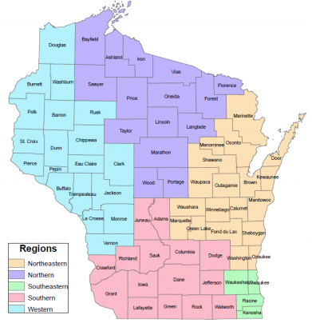
Systematic and Sustainable Structure
Governor, First Lady, Cabinet Agencies plus Department of Public Instruction (LCEY)
Governor’s Early Childhood Advisory Council (ECAC)
Interagency Workgroups
North Workgroup | Northeast Workgroup | West Workgroup | South Workgroup | Southeast Workgroup
Stakeholders
Notes:
.

Slide 23
Opportunities for the Business Community
Short-term
Share information from your business perspective to inform regional needs assessment and strategic plan
  https://dcf.wisconsin.gov/childcare/pdg/listening-sessions
Review recruitment/retention strategies, employee benefits (e.g., subsidized child care, purchasing slots for employees), and family friendly workplace policies

Slide 24
Opportunities for the Business Community
Long-term
Improve your benefits and family friendly workplace policies
Develop or participate in a shared services model (e.g., Jackson County)
Invest in child care programs close to your site
Subsidize employees’ child care costs
Use your influence to move policy and state investments
Notes:
Subsidize child care costs for your employees.
Earn a reputation as an employer with amazing benefits;
attract great talent.
Partner with local child care to invest in startup and safety costs
associated with reopening.
Ensure local child care can remain open; increase productivity and reduce time off for your employees who are parents.
Support the ECE workforce: sponsor salary bonuses for early care and education essential workers, pay off loans, or subsidize training programs.
Give back to the community, create sustainable improvements and drive economic development.

Slide 25

Notes:
Thank you!

