Slide 1
YP Strategic Session
September 2016

Slide 2
PIECE 1: Understanding Why the Chamber
1868
Businesses helping attract other businesses and helping them grow
Brought UW-L to La Crosse
Created Lang Dr.
Started Oktoberfest
1960s = Tourism
1970s = Downtown Mainstreet & LADCO

Slide 3
We Connect & Grow Very, Very Well

Slide 4
We Connect & Grow Very, Very Well

Slide 9
Unique Programs

Slide 10
We connect businesses with the community & government
DOT Meeting
Engage in Government Class
Exit 3 $1 million savings
Young Adults with Disabilities
Three-School Internship Information and …. Countless Meetings (latest = Hwy. 53 visioning)

Slide 11
We are the local voice for businesses (collectively)

Slide 12
PIECE 2: INHERITATED Out of Growing Businesses & Connecting

Slide 13
2 Years of Growth
60 in January 2015 120 in January 2016 175 currently
But with increased activity = increased time
Bobbi’s 20 hours = 29/week
Approx. $15,000 in time for $4,800 in income

Slide 14
Perspective
NonProfit Sources of Income
Events
Dues
Net $0 budget
To spend $400 on an item means you have to recruit 10 new members to pay for it
Camera Example
Tables Example
Our Challenge
To find a goal that aligns with the mission of the Chamber, our members needs & our expertise

Slide 15
Our Structure = Strategic Plan

Slide 16
Needs Based
Analysis of our four types of members & what they need
Want the Chamber to do big things
Want a tangible deliverable
Want to invest
Want to be involved

Slide 17
FOCUS 1: Growth through Talent
Our region’s low unemployment is restricting our growth in nearly all industries. We must find innovative talent solutions for business attraction, growth and startup.
LEAD in the creation of tools to attract talent to this region – particularly in fields our local colleges and universities do not entail (ex. engineering, IT, accountants, architecture, etc.).
PARTNER to find innovative solutions to increase the number of people employed to address our worker shortage due to low unemployment.
LEAD in efforts to get our young professionals -- our current and next-generation of business leaders – prepared, engaged and connected in our community.
FOCUS 2: Connect to Grow Businesses
The power of the Chamber is our ability to connect businesses with each other to address common opportunities and challenges by infusing them with shared best practices, on-going relationships, and resources.
LEAD in offering local business insight and resources that will help our businesses create growth strategies
LEAD in opportunities for businesses to grow by connecting them with other local businesses in a variety of formats
LEAD in educating them on timely information that keeps them current and competitive
PARTNER to increase the success rate of new businesses by infusing them with Chamber resources and our members body of knowledge and surrounding them with a climate that encourages entrepreneurs and local businesses – particularly women and minority-owned businesses
SUPPORT efforts to increase the number of companies’ entry into global and government contract work that support higher wages and more economic stability
LEAD efforts to pool our members buying power together to save money and offer opportunities not available or too cost-prohibitive by pursuing it alone

Slide 18
FOCUS 3: Advocate for a Thriving Business Climate
Every business located in our area is impacted by local factors – talent, infrastructure, regulation, taxation, utilities, quality of life, etc. The Chamber is the largest, collective voice in Western Wisconsin for positive changes in our community and government
LEAD in identifying and advocating for a business climate that allows businesses to thrive.

Slide 19
PIECE 3: YP Visioning “Drill Down” Survey
RESULTS

Slide 20
Who Responded
114 individuals
30% from the region (+15 La Crosse) 24% WI (outside region) 14% Minnesota 10% Other 4% Iowa 3% IL
Children: 42%

Slide 22
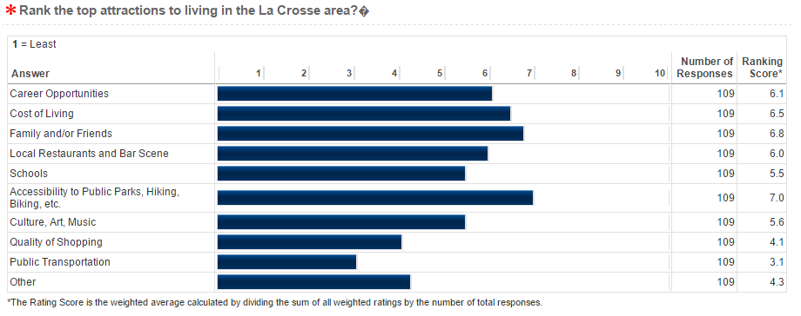
Beauty of the area, outdoors (2x)
Proximity to larger hubs (2x)

Slide 23
Want more unique / differentiation (3x)
Fewer catering to college students
Outdoor patio needed
Healthy eating options (2x) – smoothies, bagels, salads
More upscale needed
Parking issues

Slide 24
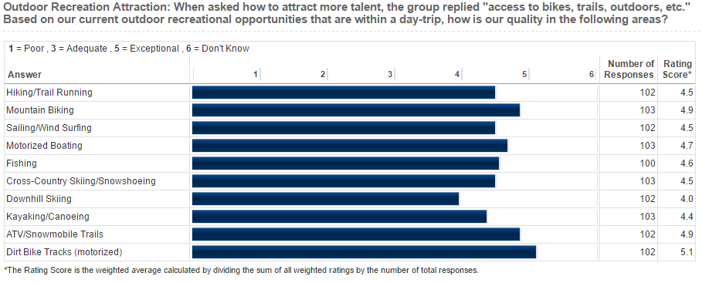
Road Biking

Slide 25
Boat Access
46 responses
Three disagreed. It’s not a good idea / fine.
2 doesn’t impact / no comment
41 all saying dock a boat and walk downtown (restaurants, shopping, etc.)
Nearby boat rental
Can see the river but not engage with it.
Better Kayak & canoe access & signage to bike trail

Slide 26
Affordability Concerns of Higher Quality in La Crosse
Property taxes too high (5x)
Low quality near downtown / aimed at college students / no middle ground (4x)
Cheaper to buy than rent (2x)
YP rent is too high
Alley concept date & non-modern homes
Pet Friendly needed (3x)

Slide 28
Continuing our Small Business/Entrepreneurial Atmosphere
45 responses
Startups with Chicago/MSP salaries
Pay scale negatively impacts employment options
Lower taxes for small business / fairness
Support / help / provide resources, microloans (7x)
Build the entrepreneurial culture (7x) – a place to thrive, business is valued, entrepreneurial thinking, pride, buy-local, embrace YP entrepreneurs (4x)
Promoting our startup businesses (2x)
It’s the American Spirit
Local businesses, not chains (2x)

Slide 29
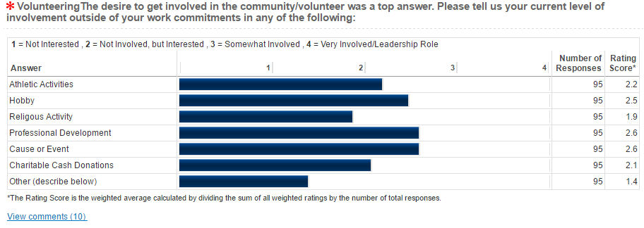
There are plenty of volunteer opportunities.

Slide 30
The trades / apprenticeships
Job shadowing
Paid internships (2x)

Slide 31
PIECE 4: Feedback & Data

Slide 32
Top Events
Young Professionals - La Crosse Loggers vs. Willmar Stingers | Loggers | Social | Evening | 6/4/2015 | 65
YPWeek: YP Comedy Night Out! | Weber Center & Piggy's | Social | Evening | 4/29/2016 | 61
YP Educational Luncheon | Chamber | Volunteering | Lunch | 7/13/2016 | 60
Young Professionals - Noon Networking Luncheon | Chamber | CEOs | Lunch | 11/4/2015 | 53
Young Professionals - Educational Luncheon | La Crosse Center | La Crosse Center | Lunch | 2/3/2016 | 52
Young Professionals - Noon Networking Event | Chamber | Personal Marketing | Lunch | 8/5/2015 | 52
Young Professionals - Quarterly Social | Pearl Street | Social | Evening | 3/3/2016 | 51
YP Community 2 Connect | La Crosse Queen | social | Evening | 7/21/2016 | 49
YP Educational Luncheon | Chamber | Tourism | Lunch | 8/3/2016 | 46
Young Professionals Noon Networking Event | Chamber | Mike Herro | Lunch | 1/6/2016 | 46
Young Professionals - Noon Networking Event | Chamber | Generations in the Workplace | Lunch | 7/1/2015 | 45
Young Professionals - Visionary Session | Chamber | Visionary Session | Morning | 4/12/2016 | 44
YPCR Social | Loggers | social | Evening | 6/2/2016 | 41
YP Week: MEllennials: The Good, The Bad, The Reality | Altra | Mellenials | Lunch | 4/27/2016 | 41

Slide 33
Events
Time | # Events | Total Attendance | Average Attendance
Lunch | 15 | 607 | 40.46666667
Morning | 4 | 87 | 21.75
Evening | 12 | 416 | 34.66666667
Late Afternoon | 2 | 41 | 20.5
 |  | 1151
Conclusion
Coffee to Connect is struggling.
Commotion to Connects are struggling.
Community to Connects are minimal
Outreach events ex. Loggers is popular

Slide 34
Comments
EP’s: want to attend your programming
EP’s want to engage with you
Observations: YPs can connect to each other but grow inclusively
YPs
Great speakers generate Buzz ex. Tourism & DMI
Like to be taken outside their usual body of knowledge
Connect with the community
“What do I do when I turn 41”
Conclusion/Recommendations
YP quarterly socials (organized by Advisors) but inclusionary events organized by the Chamber
Topics & speakers around your strategies
Connect YPs with the Community

Slide 35
Other Conclusions/Recommendations
Measuring Stick / Tool
Components of YP successful events
Create a buzz – topics that get people talking
Take YPs outside their normal body of knowledge
Connect YPs with the Community (STRATEGIC TIE-IN)

Slide 36
Other Conclusions/Recommendations
Fewer Meetings, Deeper Engagement
Monthly educations
Quarterly socials
YP groups meeting with EPs to move strategies & vision forward = transition to aging out of YPs

